Slide 1



Serverless Orchestration with Durable Functions
Callon Campbell
Systems Architect | Developer | Microsoft Azure MVP
Cloud Mavericks Inc.
Email: | Callon@CloudMavericks.ca
Blog: | TheFlyingMaverick.com
Twitter: | @Flying_Maverick
GitHub: | GitHub.com/calloncampbell

Slide 3

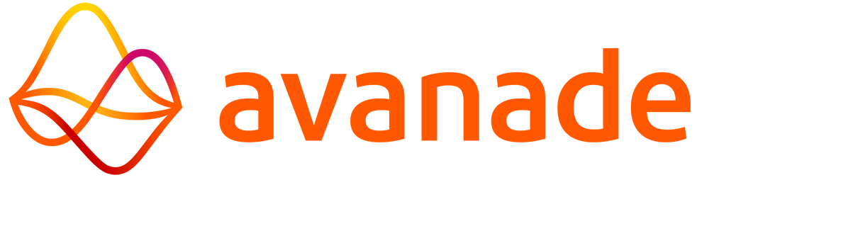

gab.SetLocalSponsors(new List<Sponsor> {
new { Logo = },
new { Logo = },
new { Logo = },
});

Slide 4

Agenda
Serverless refresher
Serverless challenges
Solutions through Durable Functions
Demos
Wrap up
Notes:
Overview – Serverless and what are Azure Functions
Dev tooling – Tools along with deployment and monitoring capabilities

Slide 5
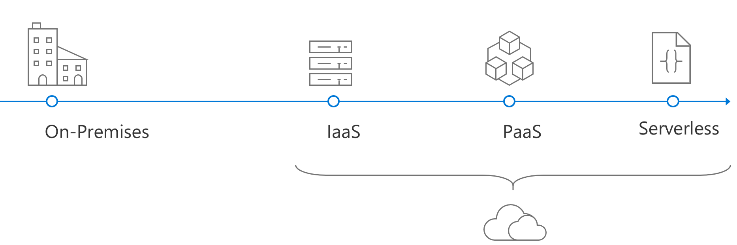
The evolution of application platforms
Notes:
Serverless is the culmination of several iterations of cloud platforms.
The evolution began with physical metal in the data center and progressed through…
Infrastructure as a Service (IaaS)
Containers as a Service (CaaS)
Platform as a Service (PaaS)
Serverless

Slide 6
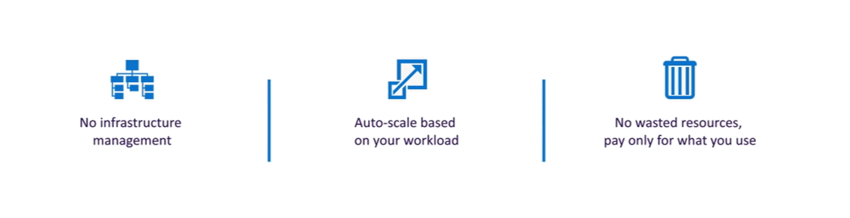
Focus on code, not plumbing
Notes:
With serverless, infrastructure is abstracted. It’s not that there are no servers, just none you need to worry about.
Serverless further abstracts servers by focusing on event-driven code. This allows you to dynamically and elastically scale to meet demand.
Serverless is micro-billing, there is no wasted resources and you’re only paying for what you use.
Allows you as the developer get to focus on the fun stuff…your code and business logic. Everything else is taken cared for you, and it drastically increases time to market.

Slide 7
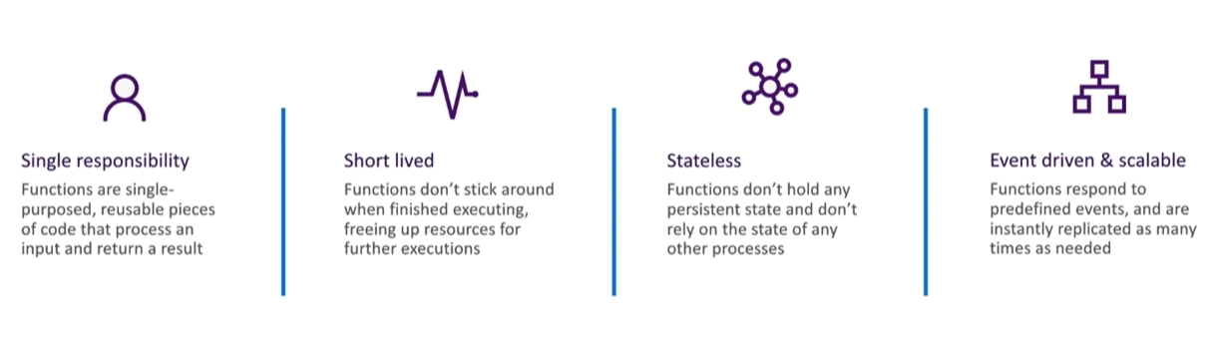
FaaS is at the center of serverless
Functions-as-a-service programming model use functions to achieve true serverless compute
Notes:
At the center of serverless is FaaS – Functions as a Service, which is small pieces of code that spin up and down as needed.
Functions should be single purposed and single responsibility pattern.
Functions should be short lived.
With serverless there is no state.
But when you require state it gets tricky.
Also what if your task isn’t short lived, or simple?

Slide 8









What is Azure Functions?
Events
Code
Outputs
React to timers, HTTP, or events from your favorite Azure services, with more on the way
Author functions in C#, F#, Node.JS, Java, and more
Send results to an ever-growing collection of services

Slide 9
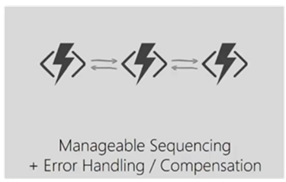
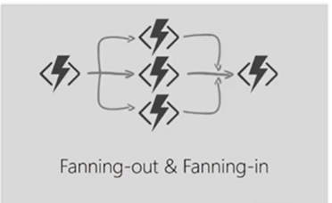
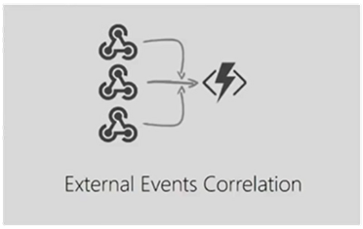
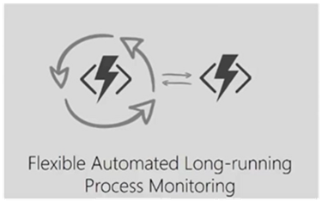
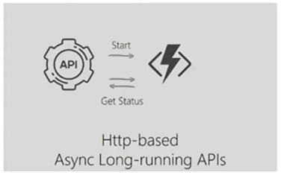
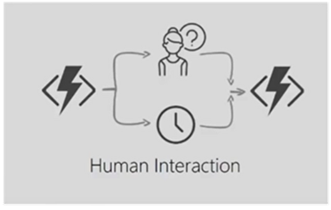
What’s still hard?
Notes:
Here are some patterns that are still hard in the serverless world (until Durable Functions…spoiler alert)
What if…
I have some sequencing that needs to happen, and I must chain them all together?
I want to parallel some work and then pull in the results into one function?
I’m waiting on external events?
I’m using the watcher pattern and I’m waiting on something?
I have or need long running http requests?
I have human interaction and I don’t want to wait forever…I want a timeout.
The answer to some of these is I don’t know. Let’s look at two patterns and see how we can solve them.

Slide 10
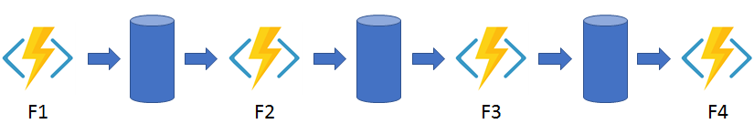
Pattern #1: Function chaining
Problems:
No visualization to show relationships between functions and queues
Middle queues are an implementation detail – conceptual overhead
Error handling adds a lot more complexity

Slide 11
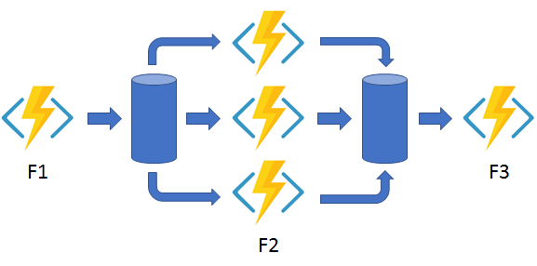
Pattern #2: Fan-out/fan-in
Problems:
Fanning-out is easy, but fanning-in is significantly more complicated
Functions offers to help with this scenario today
All the same problems as the previous pattern

Slide 12
Introducing Durable Functions
Write long-running orchestration as a single function while maintaining local state
Simplify complex transactions and coordination (chaining, fan-out/fan-in, etc.) with a new function called orchestrator function
All of the above using code-only. No JSON schemas. No UI/graphical designer
Support for C#, F#, and JavaScript only for v2
Notes:
Durable Functions is an open source extension for Azure Functions.
It allows you to coordinate long running stateful workflows in code. This means no JSON schemas or designers are needed.
With Durable Functions, you can call other functions synchronously and asynchronously. Output from called functions can be saved to local variables and used by other functions.
Durable Functions will automatically checkpoint their progress whenever the function awaits. Local state is never lost if the process recycles or the VM reboots.
Language support…C#, F# and JavaScript with v2.
The primary use case for Durable Functions is simplifying complex, stateful coordination requirements in serverless applications.

Slide 13
Application Patterns
The primary use case for Durable Functions is simplifying complex, stateful coordination requirements in serverless applications.
Typical application patterns that can benefit from Durable Functions:
Chaining
Fan-out/fan-in
Async HTTP APIs
Monitoring
Human interaction

Slide 14
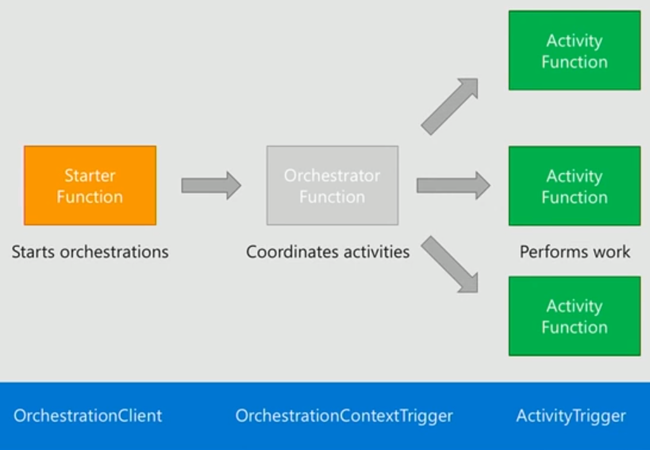
Components of Durable Functions
The Durable Functions has 3 components:
Starter Function (Fs)
Orchestrator Function (Fo)
Activity Functions (Fa)
Notes:
Durable Functions introduces the concept of an orchestrator function.
Like all Azure Functions you need to a trigger to start the function and that is exactly what the Started function does, and it will send a message to the orchestrator. Often this starter function is an Http endpoint.
Once the starter has called the orchestrator function, it goes to sleep until it’s triggered again. This reduces the cost significantly.
The orchestrator function is the heart of the Durable Function is responsible for calling and receiving the output of the activity functions (what you know as normal functions). What’s important to know is that the orchestrator is not calling the activity function directly.
The activity function are what does the work and its output becomes part of the local state of the orchestrator function.

Slide 15











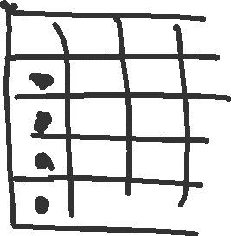
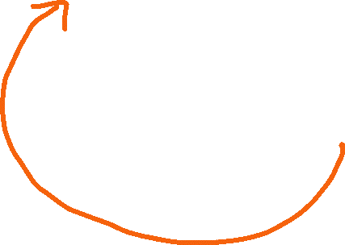
Invocations, Checkpoints, and Replay
https://docs.microsoft.com/en-us/azure/azure-functions/durable/durable-functions-checkpointing-and-replay
Notes:
The Orchestrator function provides at least once guarantee of execution and executes it in the order it supposed to happen.
This is done through event sourcing.

Slide 16
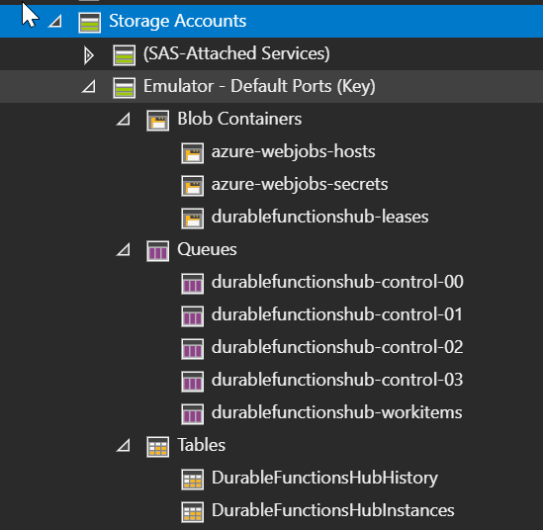
Storage Types Used by Durable Functions
Notes:
Behind the scenes Durable Functions is leveraging Azure Storage in the form of Blob Containers, Queues and Tables and this is all managed for you.

Slide 17
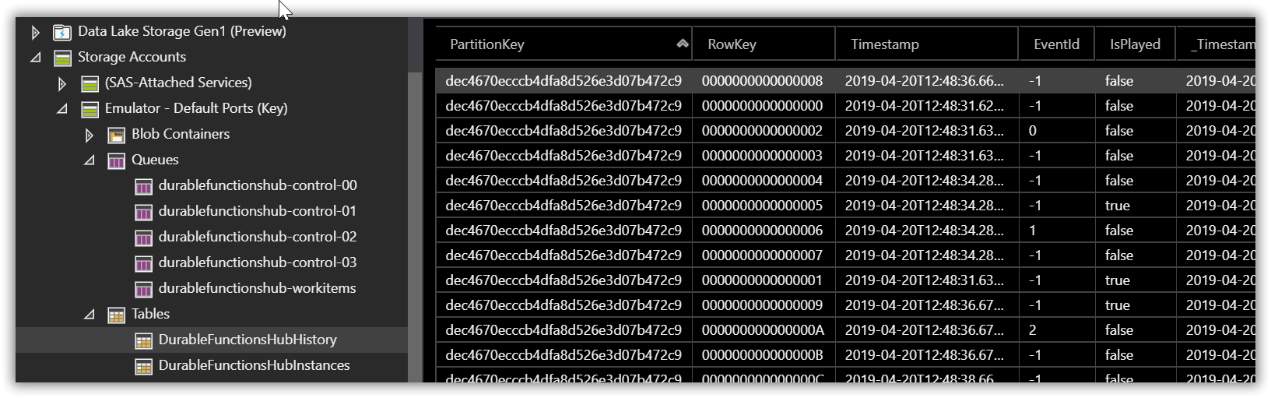
Event Sourcing Log
State is persisted in Table Storage
Notes:
In the diagram I showed previously as each function was being called the state was being persisted. If you want to take a look use Azure Storage Explorer to see the event source history.
This is what is used for replay which I will talk about shortly.

Slide 18
New Trigger Bindings
Notes:
With Durable Functions we have new trigger bindings.

Slide 19
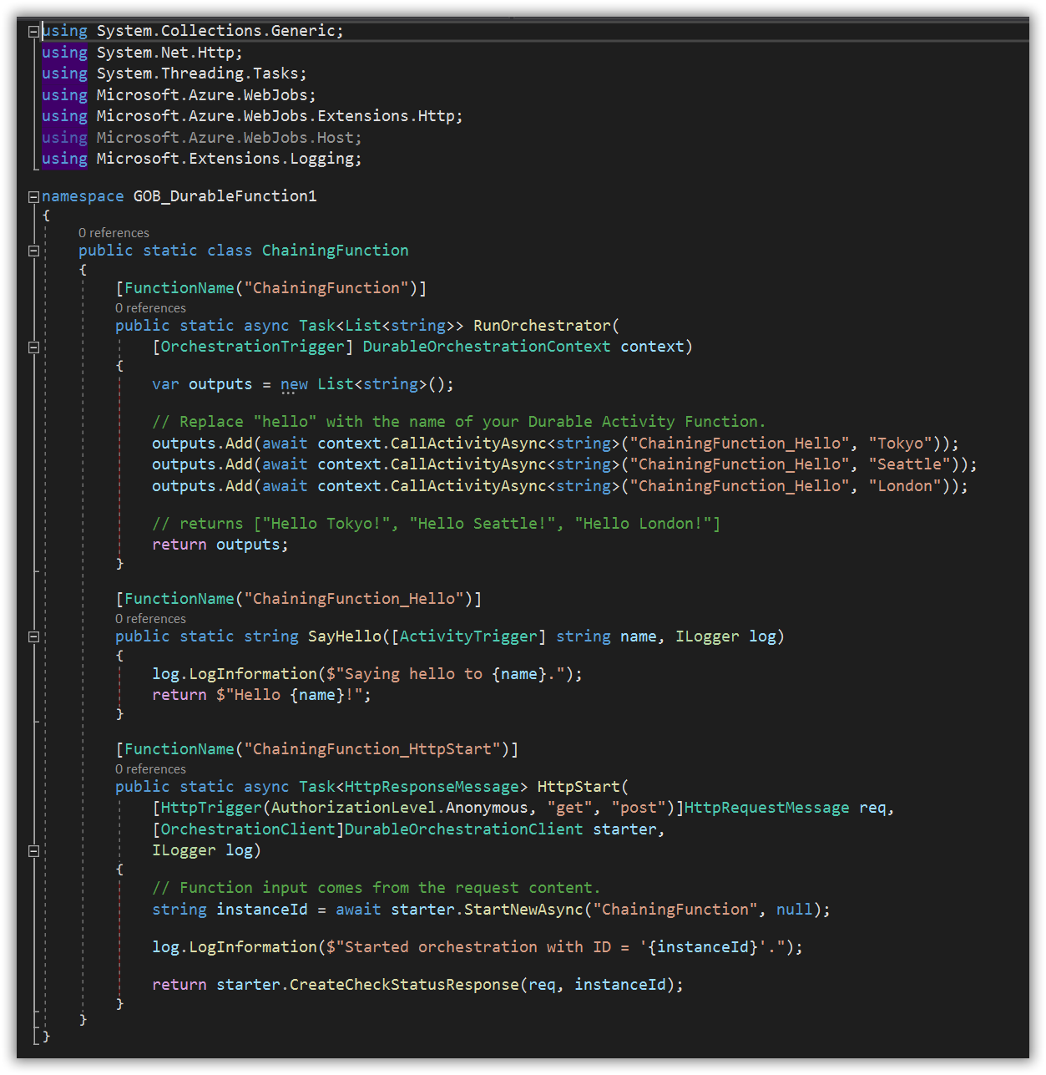
The Code
Function chaining sample
Notes:
This was scaffolded out by the Visual Studio templates.

Slide 20
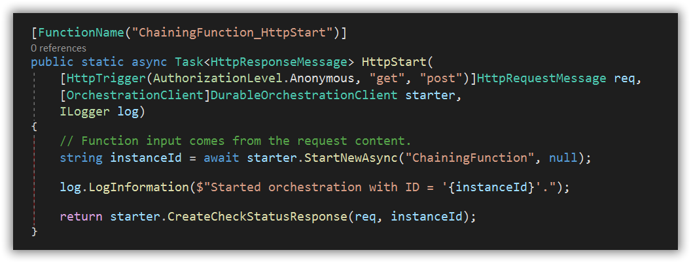




Starter Function
The Orchestration Client is the entry point - starter function
Notes:
Notice the OrchestrationClient attribute.
Using this client, you start a new Orchestration function with the StartNewAsync(string, object) where…
1st parameter is the name of the durable orchestrator function
2nd parameter is the JSON-serializable input value which you would use to provide input data to the orchestrator
The second key thing to notice is that the orchestration client returns a CheckStatusResponse which contains a set of URLs for inspecting the status of an orchestration execution. The default endpoints you get back are: (GO TO NEXT SLIDE)

Slide 21
URLs for checking status of execution
StatusQueryGetUri
SendEventPostUri
TerminatePostUri
RewindPostUri
Notes:
StatusQueryGetUri - Get the status of a running orchestration instance.
SendEventPostUri - Send an event notification to a running orchestration instance.
TerminatePostUri - Terminate an instance of a running orchestration.
RewindPostUri - Rewind a running orchestration instance to a replay events from a previous checkpoint.

Slide 22
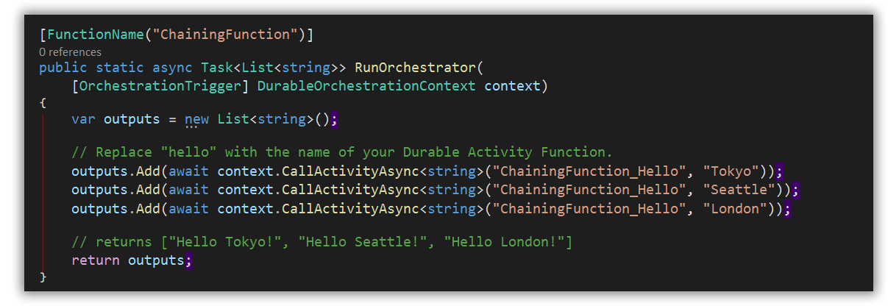


Orchestrator Function
Orchestration function is the conductor and responsible for coordinating requests to activity functions
Notes:
You will notice that the function is decorated with an OrchestrationTrigger attribute which exposes the DurableOrchestrationContext. This context is what is used to invoke and interact with Activity functions.
The orchestrator function checkpoint their progress after each await. The above code therefore executes each Activity function in series, only progressing to the next function after the current invoked function returns.
Extra info: If you wanted to execute all of the above Activity functions in parallel, you would create a list of Task objects that represent the asynchronous operations and then call Task.WhenAll(List<Task<string>)

Slide 23
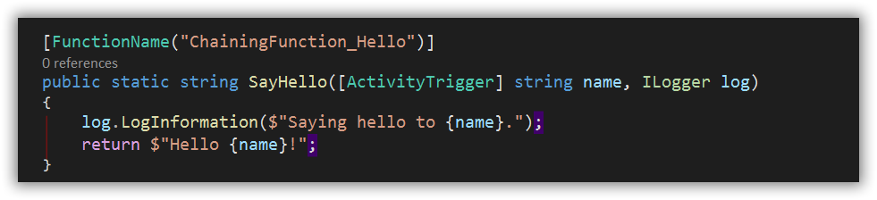


Activity Function
The activity function is the equivalent of a regular Azure Function with one difference – it was invoked by a durable orchestrator
Notes:
It performs some logic in a stateless way and returns a response to its parent orchestration function and…
The activity function is decorated with an ActivityTrigger attribute.

Slide 24
Prerequisites
Install Visual Studio 2017/2019 and ensure Azure development workload is installed. Also works with Visual Studio Code and Visual Studio for Mac
Install the latest Azure Functions tools
Verify you have the Azure Storage Emulator installed and running
Azure Storage Explorer (optional)

Slide 25
Demo 1
Hello Durable Function

Slide 26
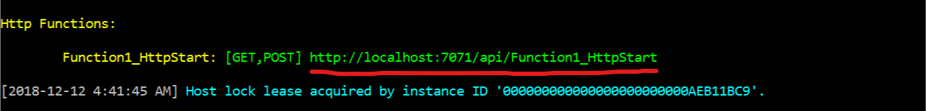
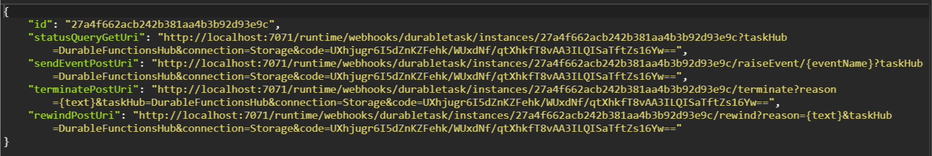
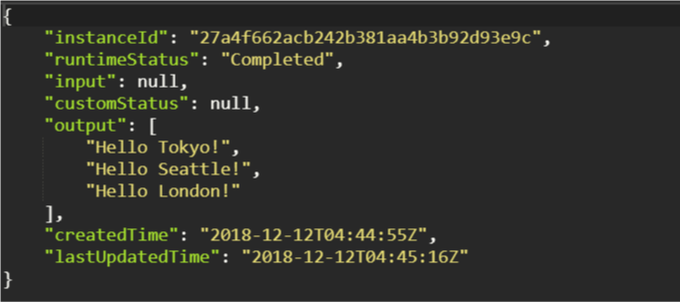
Triggering our Function
Notes:
We can easily test this out by pasting the starter function URL into the browser or via PostMan. We will then get back a list of URLs as mentioned earlier.
If we navigate to the StatusQueryGerUri, we can observe the status of the durable function instance.
In this example the orchestrator client is an HttpTrigger. It’s important to note that the OrchestratorClient can be triggered by any of the supported Azure Function triggers: TimerTrigger, QueueTrigger, CosmosDbTrigger, etc.

Slide 27
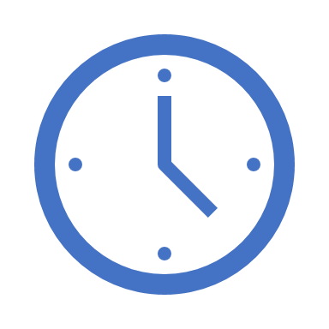

var outputs = new List<string>();
outputs.Add(await context.CallActivityAsync<string>("SayHello", “Amsterdam"));
return outputs;
Orchestrator Function
Orchestrator Function
Activity Function
Orchestrator Started
Activity Function
Execution Started
Task Scheduled, SayHello, “Amsterdam”
Orchestrator Completed
[“Hello Amsterdam!”]
“Hello Amsterdam!”
“Hello Amsterdam!”
Task Completed, “Hello Amsterdam!”
?
Orchestrator Started
Execution Completed, ["Hello Amsterdam!"]
Orchestrator Completed
Execution History
Notes:
So how does this all work?
Durable Functions uses a pattern called “Event Sourcing” to store state in a backing storage account, which is how it’s made durable.
Once the orchestrator calls activity function, the orchestrator goes to sleep and scales down to 0. When the activity function is complete it signals the orchestrator function to start up.
When the orchestrator functions starts back up, it starts all over again and is something to keep in mind when developing and debugging your durable functions. If you take one key point from this talk is should be this.
You’re only paying for the time your activity function is running and when your orchestrator function is running, but not both at the same time.
NOTE: You would not use an orchestrator to call a single function.

Slide 28
Demo 2
Function Chaining
Find a Star Wars character and their home planet

Slide 29



Function Chaining
Planet URL ->
Partial character name ->
<- Planet name
<- Character name +
Planet name
<- Character +
Planet URL
HttpStart
GetCharacterInfo
SearchCharacter
GetPlanet

Slide 30
Demo 3
Fan-Out/Fan-In
Find a Star Wars planet and their residents

Slide 31


Fan-out/Fan-in
For each resident URL
In [resident URLS] ->
Partial planet name ->
<- Character name
<- Planet name +
[resident name]
<- Planet +
[resident URLs]
HttpStart
GetPlanetResidents
SearchPlanet
GetCharacter

Slide 32
Closing Remarks
Input/output of functions should be serializable
Orchestrator code must be deterministic. Never use random numbers, DateTime.UtcNow, Guid.NewGuid(), etc.
Use DurableOrchestrationContext.CurrentUtcDateTime
Orchestrator code should be non-blocking. Never do I/O directly in the orchestrator
Do I/O in activity functions
Don't write infinite loops
Use DurableOrchestrationContext.ContinueAsNew()
Notes:
Orchestrator code must be deterministic, as it will be replayed multiple times and must produce the same result each time.

Slide 33
Closing Remarks (cont.)
Orchestration Functions can only call Activity Functions in the same Function App
Don’t use an orchestration function to call a single activity function
Keep your orchestrations small
What changes together should be deployed together

Slide 34
Summary
Azure Durable Functions make managing state and complex workflows easy and familiar

Slide 35

Thank you!
Callon@CloudMavericks.ca
TheFlyingMaverick.com
@Flying_Maverick
GitHub.com/calloncampbell

Slide 36
References
Durable Function Docs: http://aka.ms/durablefunctions
GitHub:
https://github.com/Azure/azure-functions-durable-extension
https://github.com/Azure/durabletask/tree/azure-functions
Orchestrator code constraints
Develop Azure Functions using Visual Studio
Serverless use cases and best practices
Azure Durable Functions: before and after

